Slide 1
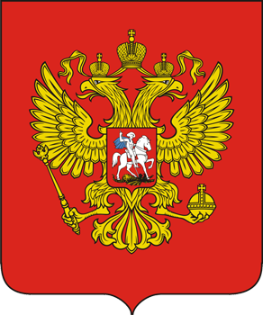
Russian eagle

Slide 2
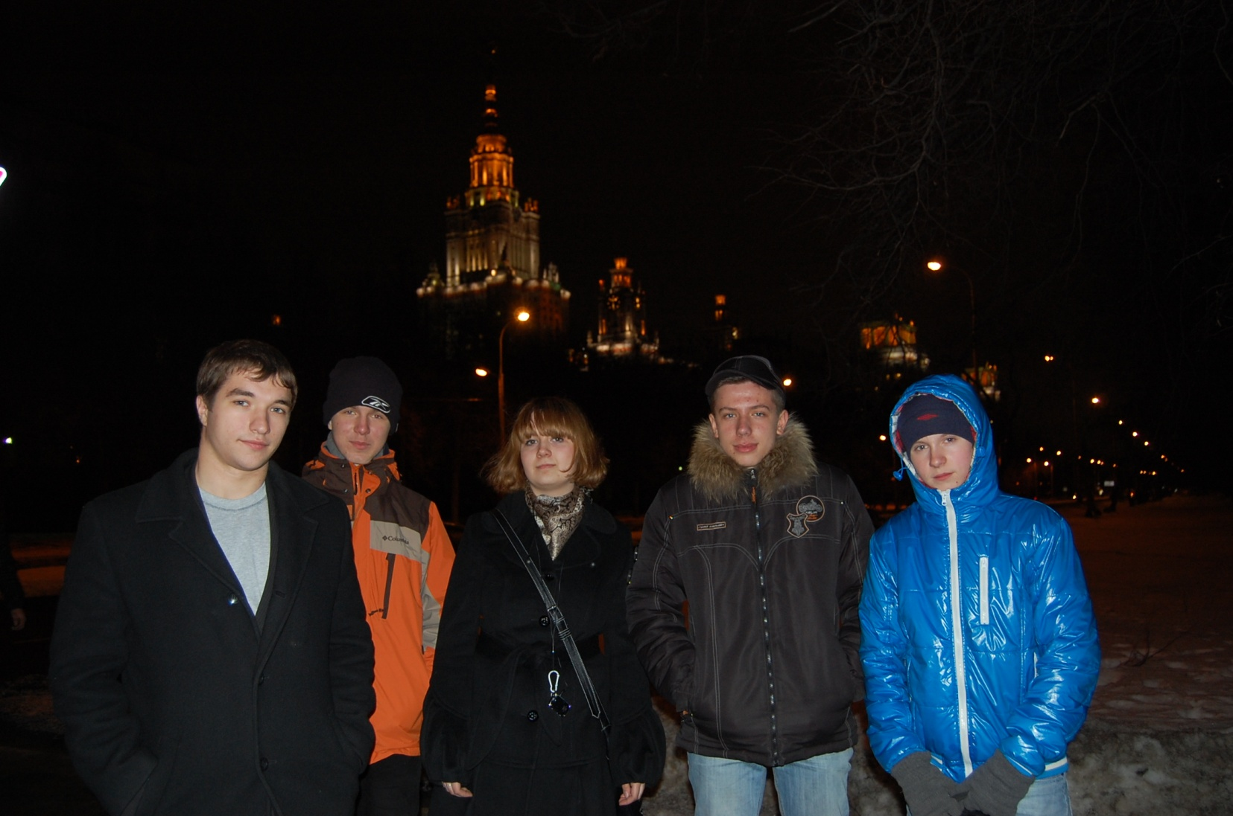
Our Team
We welcome you to our presentation!
We are the Moscow team of CanSat. From left to right: Y. Rasskazov – captain of our command, A. Kalach – designer & maker of our parachute system, A. Alexeeva – programmer, G. Vousch – technician, D. Bushuev - a generator of ideas and the creator of the parachute system. We started our work in that format.

Slide 3
Our Mission
- completing of main mission of CanSat;
- shooting of Earth’s surface;
- transmitting videostream from board to ground station;
- recording videostream from board to laptop or other devices;
- development effective parachute system

Slide 4
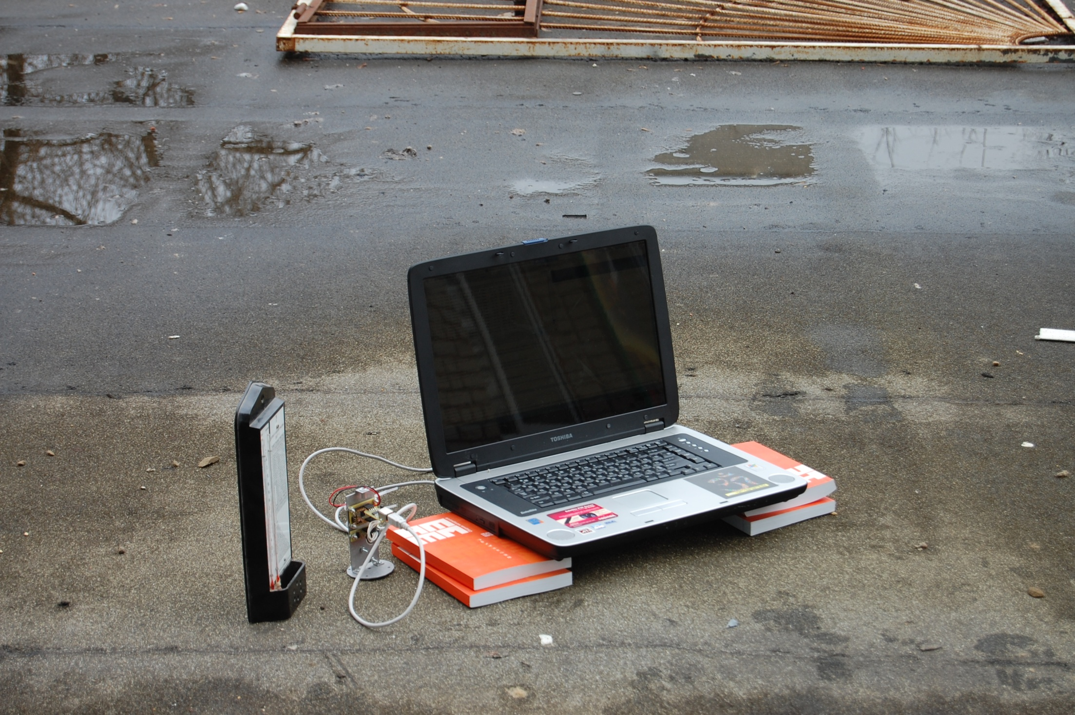
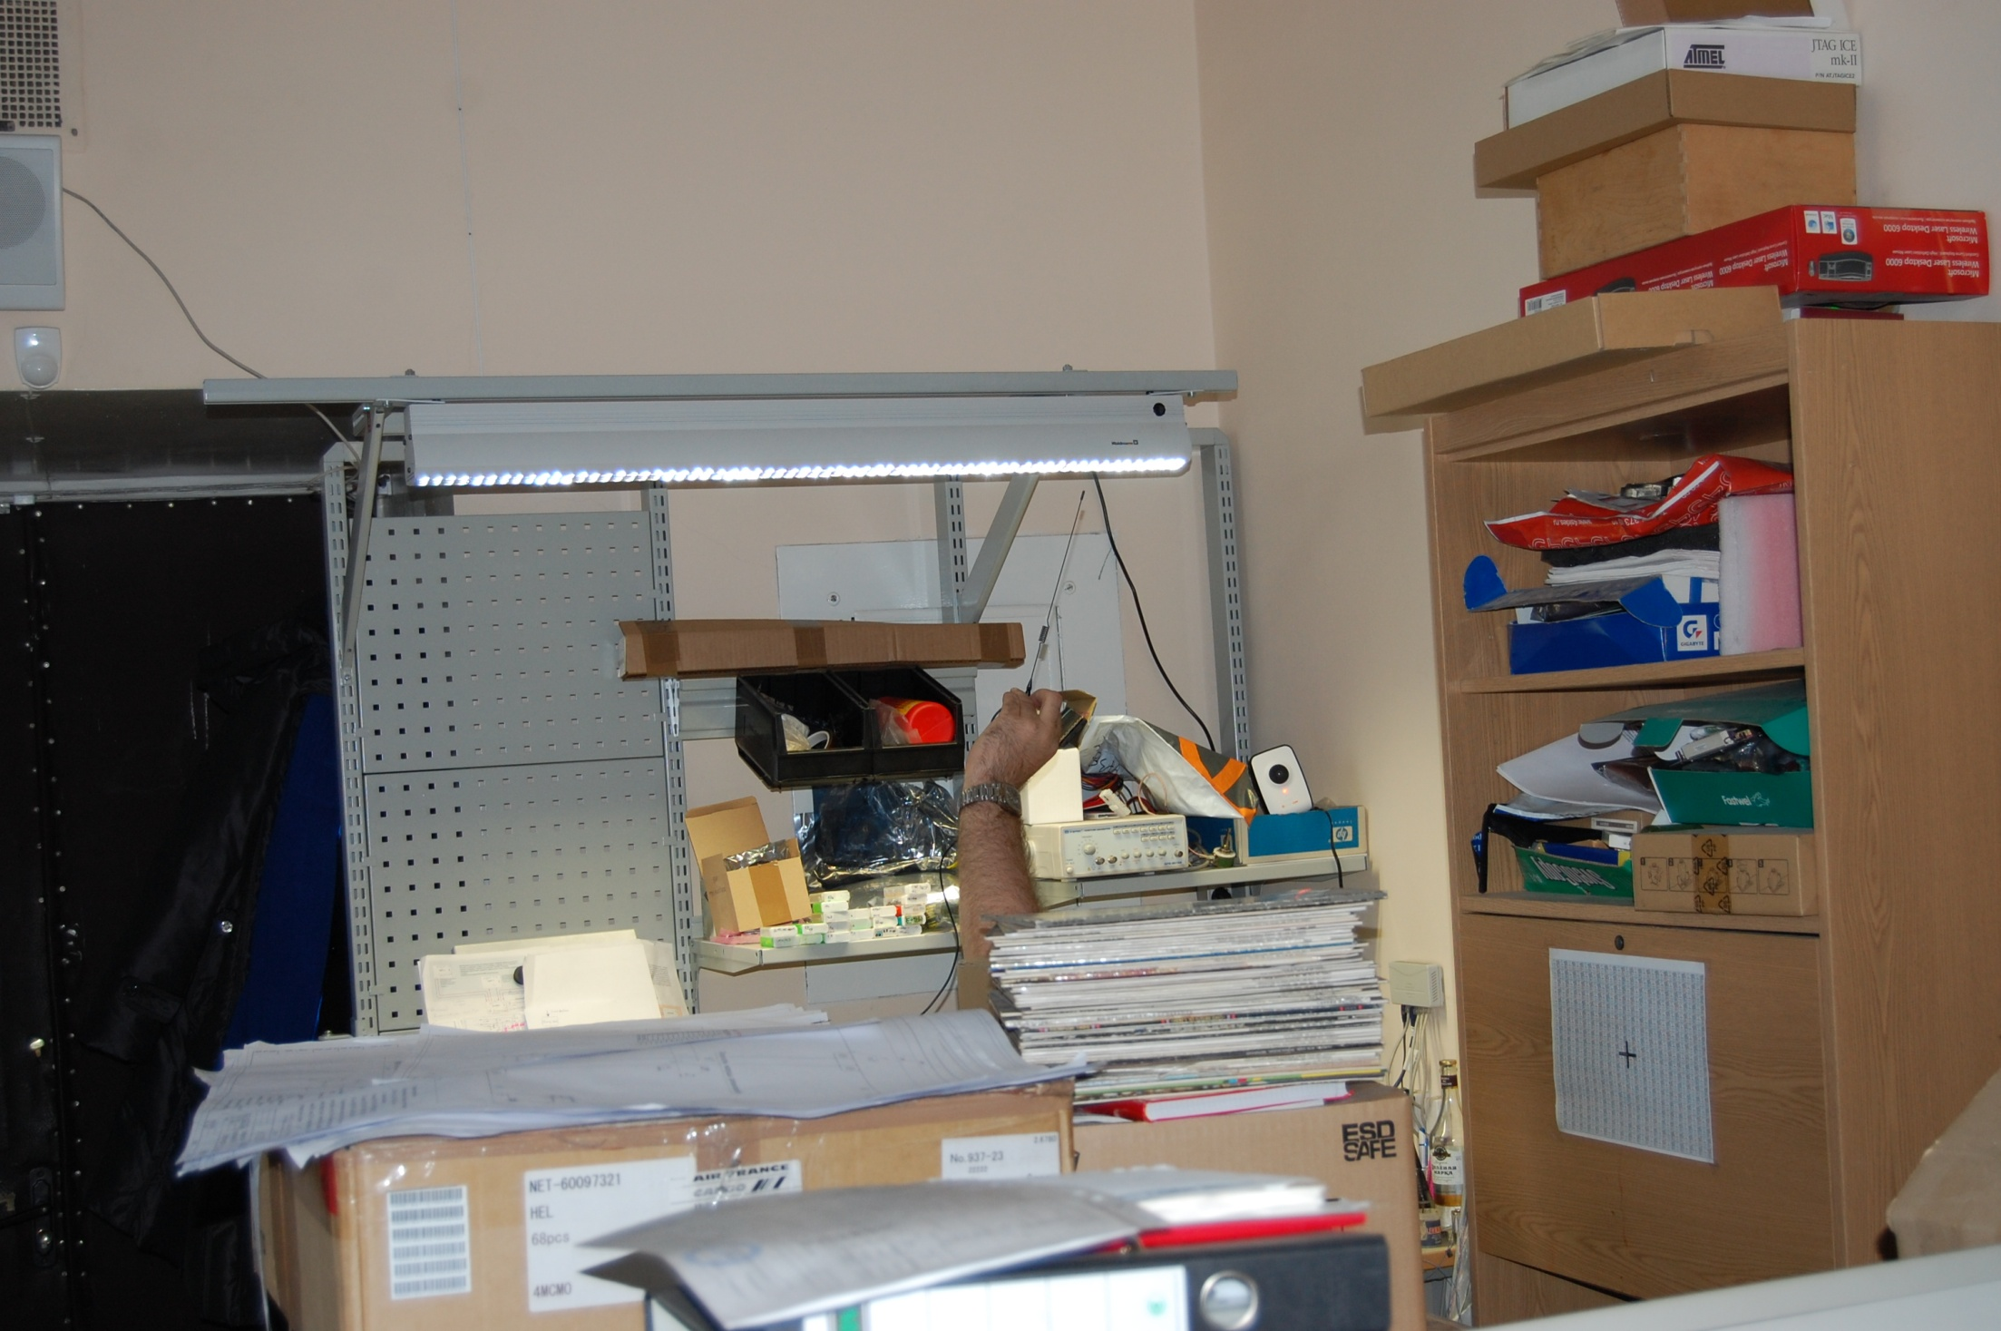
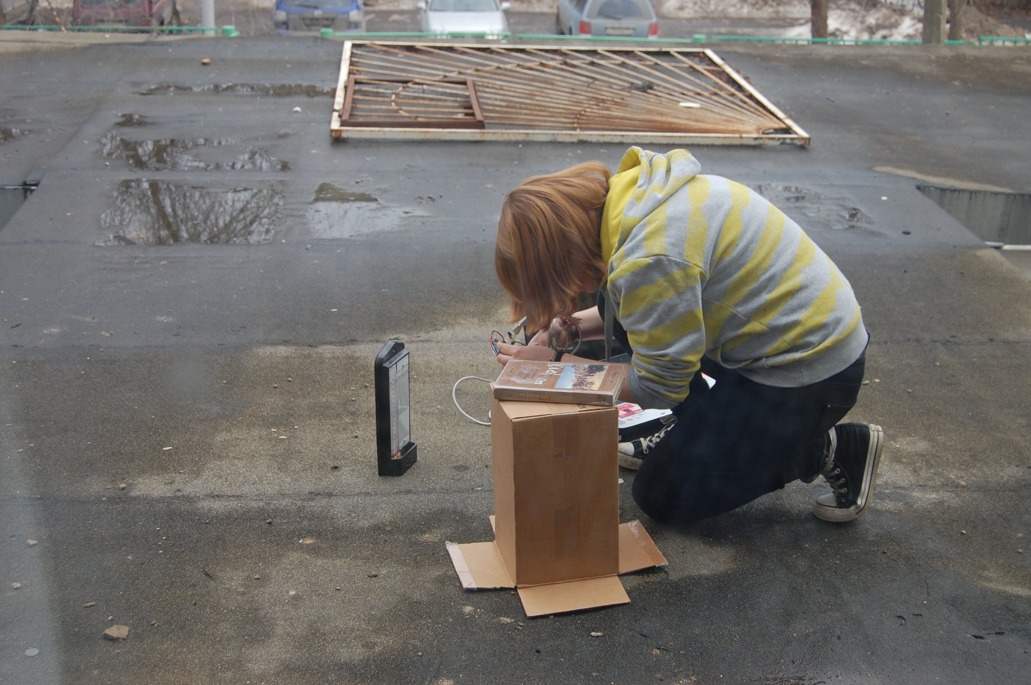
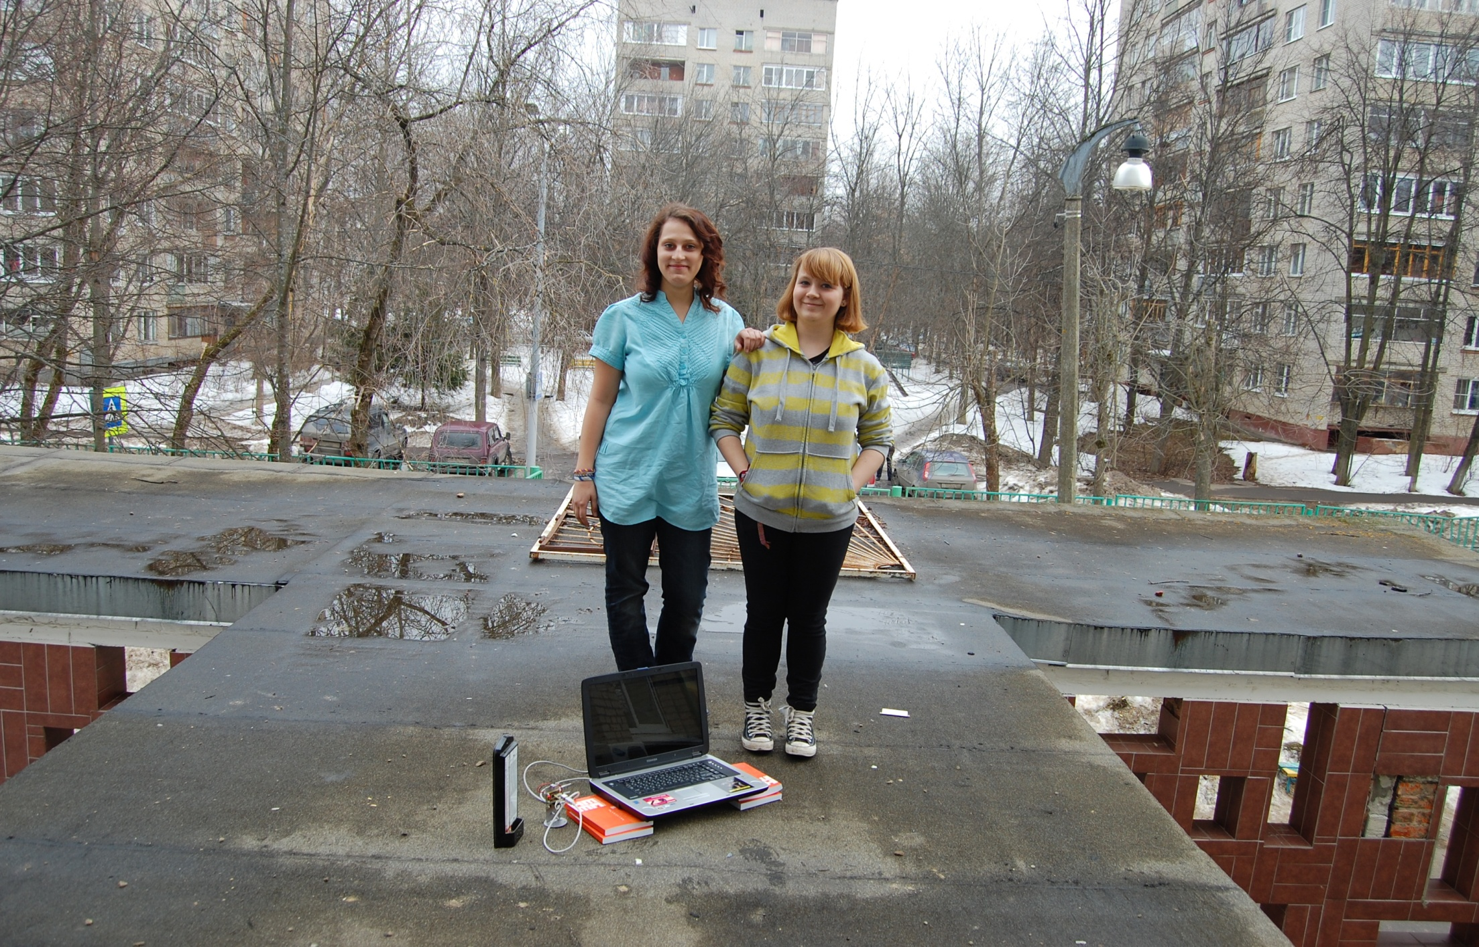
Main Mission

Slide 5
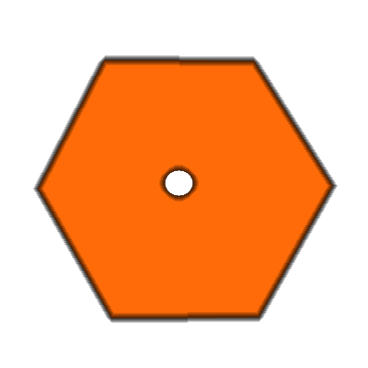
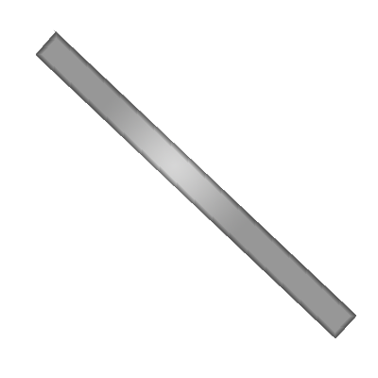
Parachute System

Slide 6
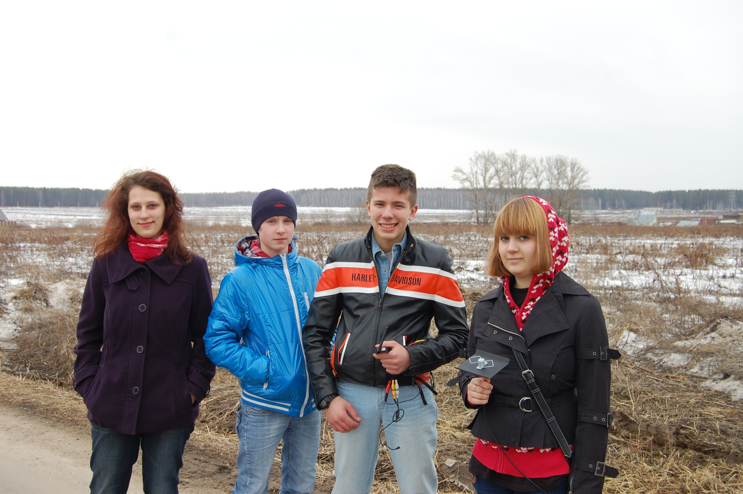
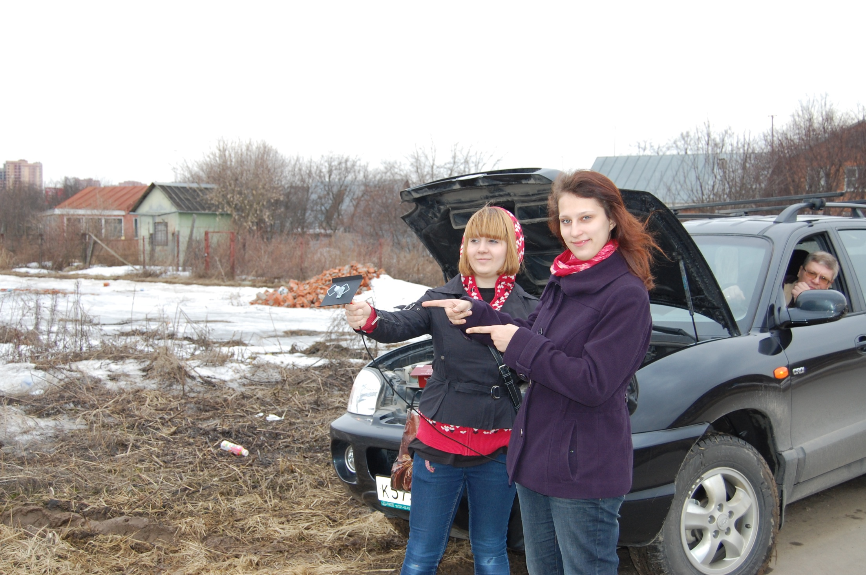
Videosystem

Slide 7
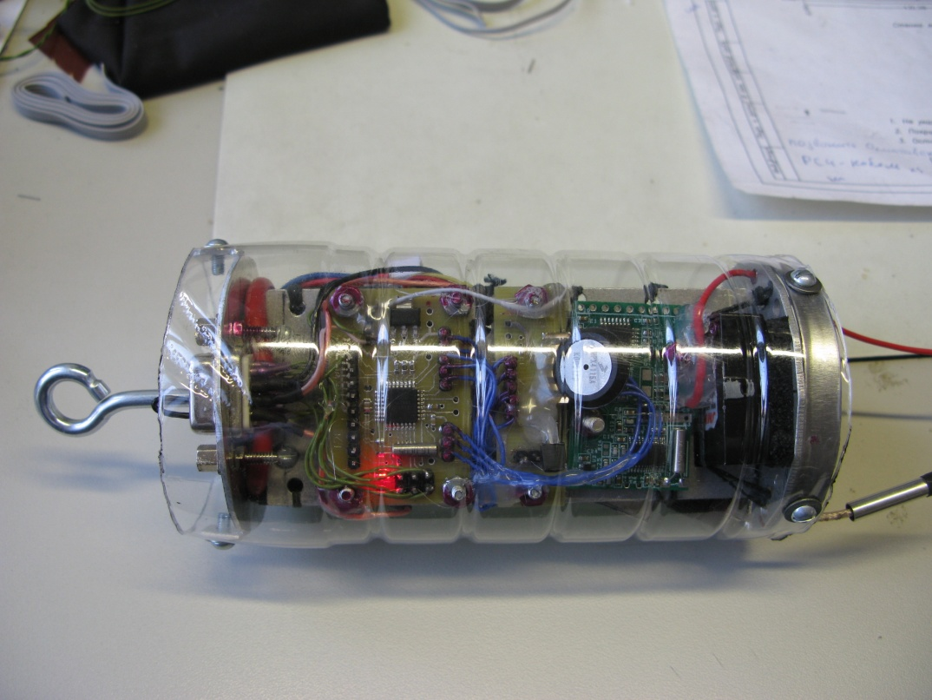
Our Sattelite
Specifications
Weight – 340 g
Operating frequencies – 460 MHz, 5.4 GHz
Communication range – 1,5-2 Km (1-1,3 miles)
Battery life – 3-5 hours
Video size – 704x576 (max)
Thanks for you attention!

